Slide 1
Object Oriented Programming Lecture 4

Slide 2
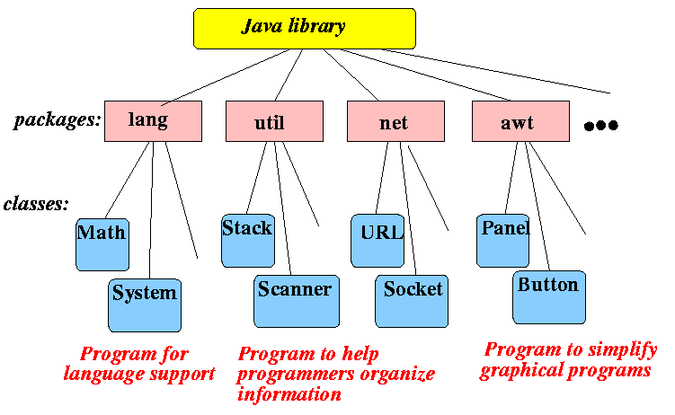
Java Library

Slide 3
Interactive Programs
We have written programs that print console output, but it is also possible to read input from the console.
The user types input into the console. We capture the input and use it in our program.
Such a program is called an interactive program.
Interactive programs can be challenging.
Computers and users think in very different ways.
Users misbehave.
System.out
An object with methods named println and print
System.in
not intended to be used directly
We use a second object, from a class Scanner, to help us.

Slide 4
Example
package test;
import java.util.*;
public class Input {
public static void main(String[] args) {
Scanner s =new Scanner(System.in);
s.next();
}
}

Slide 5
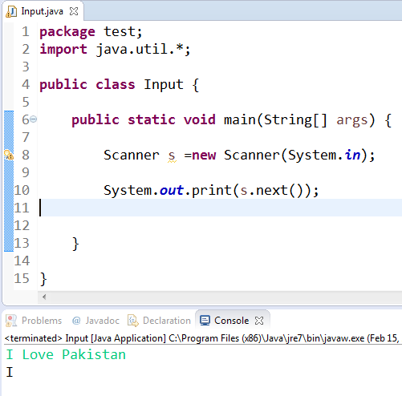
Example
package test;
import java.util.*;
public class Input {
public static void main(String[] args) {
Scanner s =new Scanner(System.in);
System.out.print(s.next());
}
}
I Love Pakistan
I

Slide 6
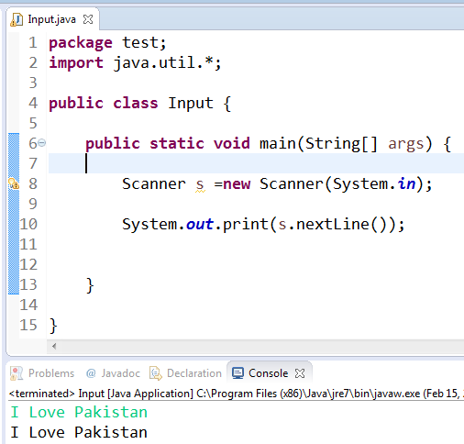
Example
package test;
import java.util.*;
public class Input {
public static void main(String[] args) {
Scanner s =new Scanner(System.in);
System.out.print(s.nextLine());
}
}
I Love Pakistan
I Love Pakistan

Slide 7
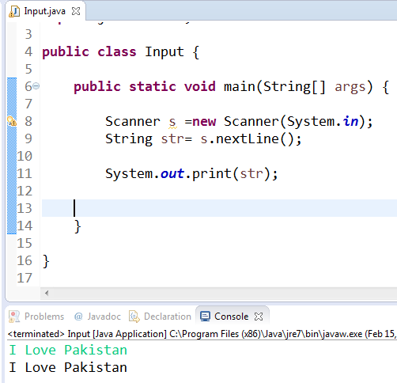
Example
package test;
import java.util.*;
public class Input {
public static void main(String[] args) {
Scanner s =new Scanner(System.in);
String str= s.nextLine();
System.out.print(str);
}
}
I Love Pakistan
I Love Pakistan

Slide 8
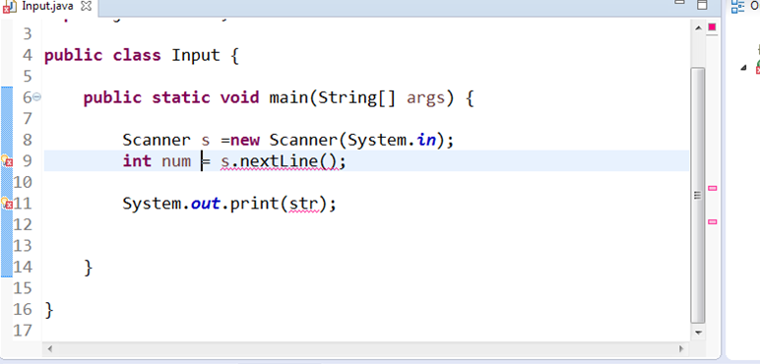
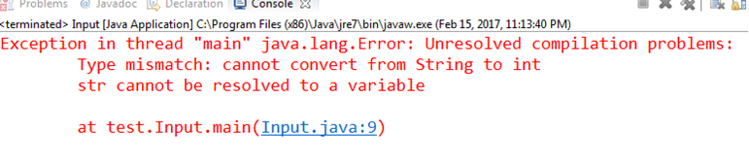
Example

Slide 9
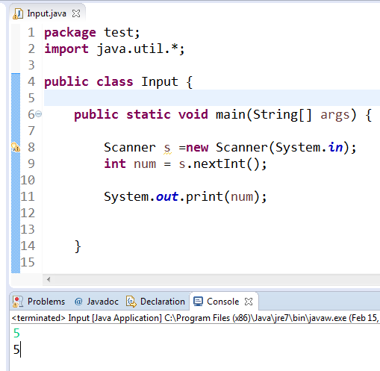
Example
package test;
import java.util.*;
public class Input {
public static void main(String[] args) {
Scanner s =new Scanner(System.in);
int num = s.nextInt();
System.out.print(num);
}
}
5
5

Slide 10
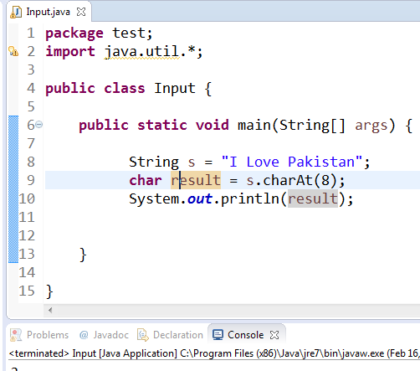
Example
package test;
import java.util.*;
public class Input {
public static void main(String[] args) {
String s = "I Love Pakistan";
char result = s.charAt(8);
System.out.println(result);
}
}
a

Slide 11
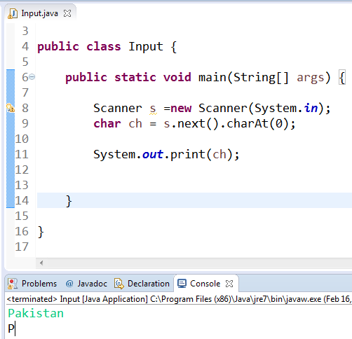
Example
package test;
import java.util.*;
public class Input {
public static void main(String[] args) {
Scanner s =new Scanner(System.in);
char ch = s.next().charAt(0);
System.out.print(ch);
}
}
Pakistan
P

Slide 12
Example
package test;
import java.util.*;
public class Input {
public static void main(String[] args) {
Scanner s =new Scanner(System.in);
char ch = s.nextLine().charAt(0);
System.out.print(ch);
}
}
I love Pakistan
o

